Slide 1
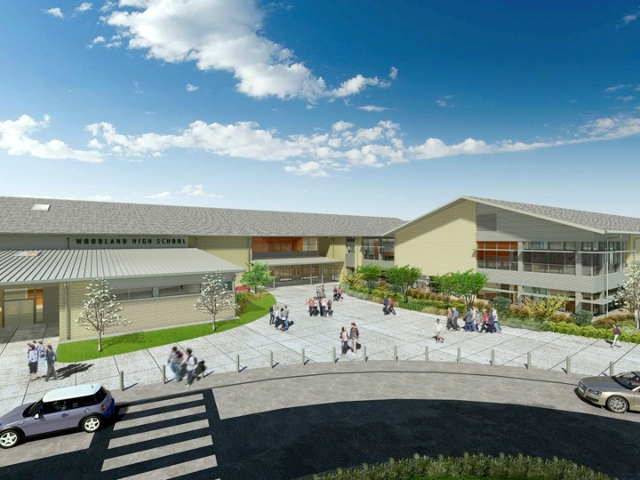
Woodland Public Schools
Facilities Report May
2023

Slide 2
Facilities Report
Office Security installation update — New lockdown systems and AIPhones installations are complete. All systems are now operational. We are still fine tuning the systems, with a few additional adjustments for better performance and functionality.
Middle School roof replacement update — We are looking at doing a phase replacement for our failing roof with the levy failure. We will be reaching out to our bidders for alternative estimates to address the areas with the most urgent need for replacement.
In ground heating oil tank decommissioning at Yale is complete with no site contamination.
We had Walter E Nelson Company replaced all paper towel and toilet paper dispensers district wide at no cost to the district. The change was made to have the same product district wide with reduced cost. The new product comes with a similar cost per roll, but each roll has 20% more linear feet.
5th Street update — We currently have this project on hold with levy failure
Additional parking lot lighting at Columbia elementary has been completed
In March and April we closed 69 work orders, with 22 in progress.

Slide 3
Facilities Report Cont.
Our department is gearing up for summer 2023 projects. This is a list of some, but not all projects our maintenance and custodial staff will be working on this summer: Replacing and painting rotted fascia boards at WMS, Coating the flat roof on WMS wood/metal shop with silicone roof coating material that was purchased back in 2016, refinish/coat gym floors, replace and paint rotted siding at Columbia elementary.

